Slide 1


Slide 2
Professor & Lawyer
Puttu Guru Prasad
B.Com., M.Com., M.Phil., M.B.A., PGDFTM., AP.SET., M.Phil., DRMS., L.L.B.,
ICFAI TMF., DIRM., L.L.M., Pre PhD (PhD)from JNTUK., Topper
Domain Topper & 30th Batch Topper at ICFAI -2009 (TMF) (TMF) Training for Management Faculty
“Diploma in Psychology from YALE University”
MHRDI’s 'Institution's Innovation Council (IICs)Ambassador
NSS Certified Program Officer, (A.U)
LL.B Degree Gold Medallist from ANU-2005
ICFAI UNIVERSITY Trained Senior MBA Faculty
Eminent Faculty for Accounts, Business Studies, Economics,
Head, Board of Administration & Management Science,
BHAGAVAD GITA & CLAT & IPMAT Program Coordinator,
Commerce Department, VIVA-VVIT, Nambur,
My Blog: puttuguru.blogspot.in My Web Site: https://gurublogs.wixsite.com/guru
93 94 96 98 98, 9885 96 36 36, 807 444 9539,

Slide 3


Slide 4


Slide 5


Slide 6


Slide 7


Slide 8


Slide 9


Slide 10
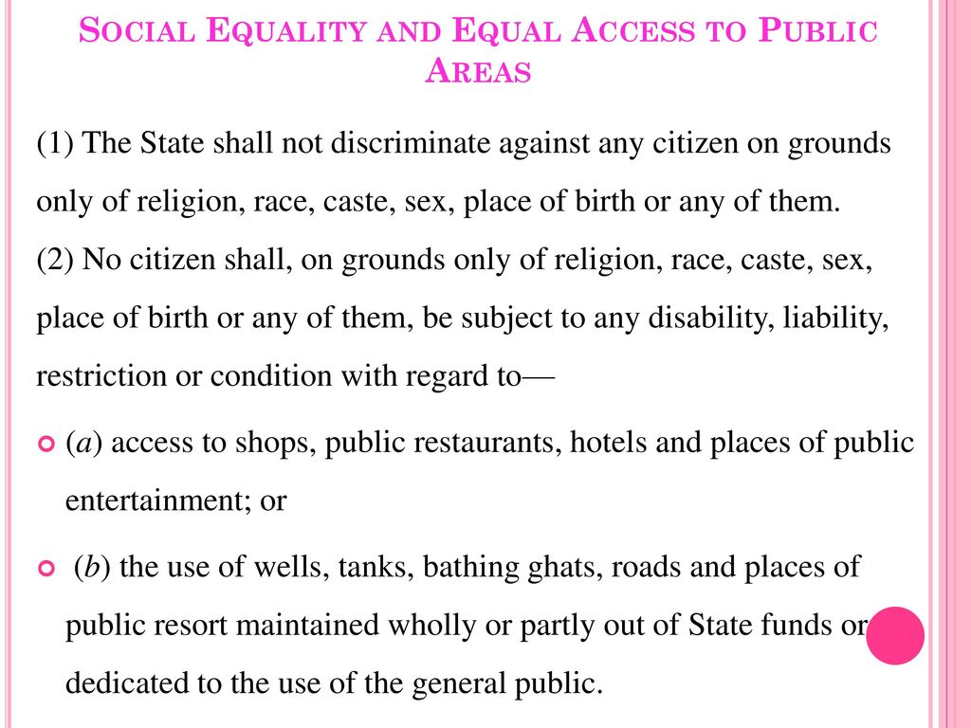

Slide 11
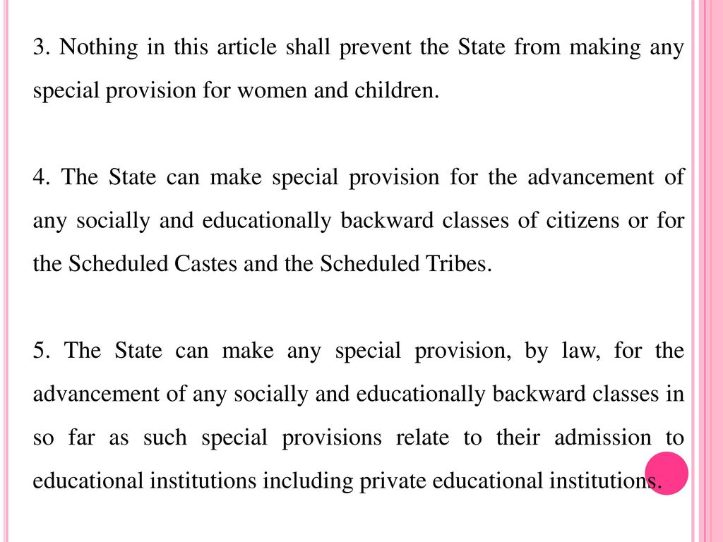

Slide 12
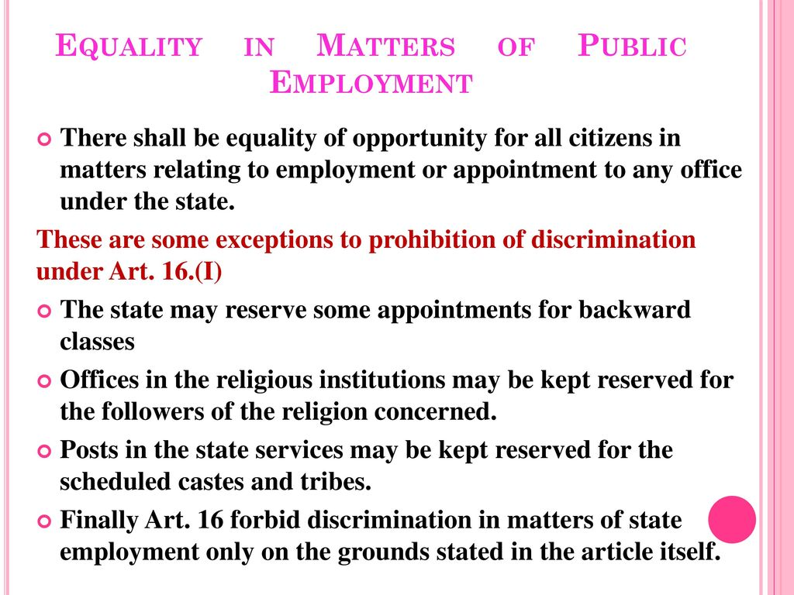

Slide 13


Slide 14


Slide 15


Slide 16


Slide 17


Slide 18


Slide 19


Slide 20


Slide 21


Slide 22


Slide 23


Slide 24


Slide 25
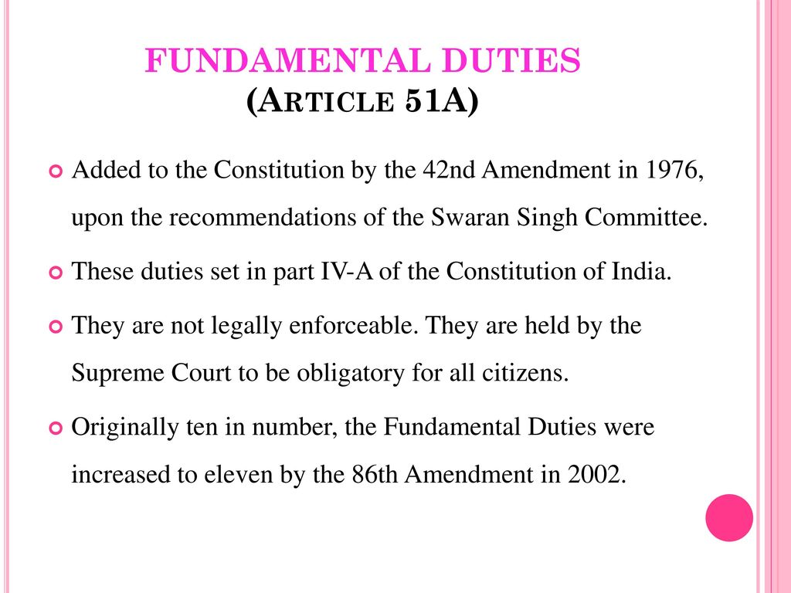

Slide 26


Slide 27


Slide 28


